Slide 1
Title : Reducing Customer Churn at SyriaTel ; Identifying At-Risk Customers Using Predictive Analysis
Subtitle : A Data-Driven Strategy to Improve Customer Retention
Presented by : LYNN KYALO
KYALOLYNN036@GMAIL.COM
https://github.com/lynnkyalo
In today’s competitive telecom industry, customer retention is a major concern. Telecom providers often struggle with churn which is a critical issue in the telecom industry, leading to revenue loss and higher acquisition costs. This project uses machine learning to predict which customers are likely to leave based on historical data such as contract type, tenure, and service usage. The goal is to help the company take proactive steps to retain at-risk customers and improve overall customer loyalty through data-driven decision-making.

Slide 2

Business Problem
What is Customer Churn? Customer churn happens when customers stop using a service. For SyriaTel, a telecommunications company, churn means a customer leaves and stops paying for their services.
Why Is This a Problem? Losing customers means losing revenue. It costs more to gain new customers than to retain existing ones.
Business Goal We want to find out which customers are most likely to leave, and what patterns predict this, so SyriaTel can take steps to keep them.
Objective of This Project
Build a predictive model to classify which customers are likely to churn.
Understand which factors (like contract type or customer support calls) most influence churn.
Help SyriaTel make data-driven decisions to reduce customer loss.

Slide 3

Understanding the data
The dataset used in this project consists of information from customers of a telecom service provider. It includes a variety of features such as:
Demographics: Gender, whether the customer is a senior citizen, whether they have a partner or dependents.
Account Information: Tenure (length of service), contract type, paperless billing, payment method, monthly and total charges.
Service Details: Types of services subscribed to, including phone service, multiple lines, internet service, online security, tech support, streaming services, etc.
Customer Interaction: Number of customer service calls.
Target Variable: The column "Churn", where "1" indicates a customer who churned and "0" indicates one who stayed.
This mix of numerical and categorical data provides a good foundation for building predictive models.
Dataset Overview:
Source - SyriaTel Customer Churn Dataset (Kaggle)
Total Records - 3,333 customer profiles
Target Variable - Churn (Yes/No)

Slide 4
Data Processing
To prepare the data for modeling, we performed several preprocessing steps:
Encoding categorical variables: Since machine learning models require numerical input, all categorical features (such as gender, contract type, and payment method) were transformed using one-hot encoding.
Handling missing values: Any missing or invalid data entries were addressed to ensure model accuracy.
Feature scaling: Continuous features like "MonthlyCharges" and "TotalCharges" were scaled using StandardScaler to bring them to the same range, which is especially important for algorithms like logistic regression.
Train-Test Split: The dataset was split into training and testing sets in an 80:20 ratio. This ensures that the model is trained on one subset of data and evaluated on another, preserving its ability to generalize.
These preprocessing steps are essential to avoid bias, handle mixed data types, and improve model performance.

Slide 5
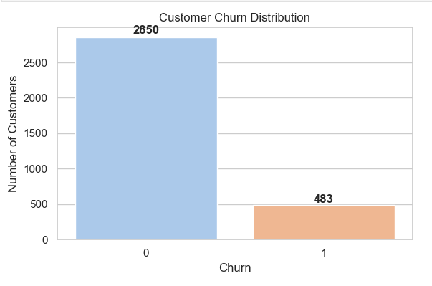
Exploratory Data Analysis (EDA) – Churn Distribution
Before building any machine learning models, it is crucial to perform Exploratory Data Analysis (EDA). EDA helps us understand the characteristics of the dataset, detect patterns, identify anomalies, and highlight relationships between variables. One of the first steps is to examine the target variable, in this case, customer churn
The churn distribution bar chart shows the count of customers who stayed (0) versus those who churned (1).
Out of the total customers in the dataset, 2,850 customers have not churned, while 483 customers have churned.
This highlights a class imbalance, where the majority of customers remain with the company, but a significant minority churn

Slide 6
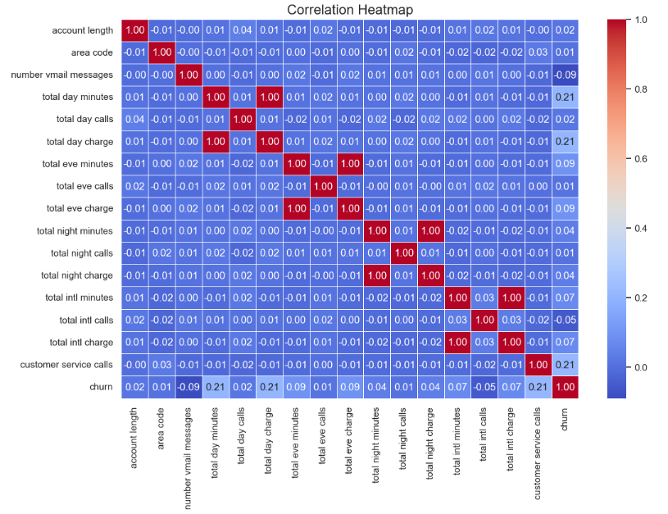
Visualization 2
The correlation heatmap provides a visual representation of the pairwise relationships between numerical features in the dataset. Each cell in the heatmap displays the correlation coefficient between two variables:
- Positive correlations (closer to +1) indicate that as one feature increases, the other tends to increase as well.
- Negative correlations (closer to -1) indicate an inverse relationship—when one increases, the other tends to decrease.
- Values near 0 suggest little to no linear relationship between the features.
In the context of customer churn:
- We observe strong positive correlations between related metrics such as:
- `total day minutes` and `total day charge`
- `total eve minutes` and `total eve charge`
- `total night minutes` and `total night charge`
- Some weak correlations may exist between churn and features like `customer service calls`, `international plan`, or `total day minutes`, which may hint at their influence on a customer's decision to leave.
This heatmap helps us identify redundant features and focus on the most relevant ones during feature selection and model building.

Slide 7

Modelling Approach
We selected two different machine learning models for comparison:
Logistic Regression: This is a linear, interpretable, and commonly used algorithm for binary classification tasks. It serves as a reliable baseline to compare against more complex models.
Decision Tree Classifier: This is a non-linear algorithm capable of capturing complex relationships between variables. It handles both numerical and categorical data well and provides insights through feature importance.
We evaluated both models using key performance metrics:
Accuracy: Proportion of total correct predictions.
Precision: Proportion of predicted churners who were actually churners.
Recall: Proportion of actual churners that were correctly predicted.
F1 Score: Harmonic mean of precision and recall, providing a balanced evaluation.
Confusion Matrix: Shows the true vs. predicted values for both churn and no-churn classes.

Slide 8

Logistic Regression Results and Interpretation
The logistic regression model produced the following results on the test data:
Accuracy: 0.848
Precision: 0.5
Recall: 0.238
F1 Score: 0.322
Classification Report:
Class 0 (Did not churn): Precision = 0.88, Recall = 0.96, F1 Score = 0.91
Class 1 (Churned): Precision = 0.5, Recall = 0.24, F1 Score = 0.32
Confusion Matrix:
True Negatives (Class 0 correctly predicted): 542
False Positives (Class 0 incorrectly predicted as churn): 24
False Negatives (Churn incorrectly predicted as non-churn): 77
True Positives (Correctly predicted churn): 24
Interpretation: The model performs well in identifying non-churners but is weak in detecting churners. It misclassifies many churners as non-churners, which makes it less useful for our business objective of churn prevention. The low recall (0.238) for churn indicates the model fails to flag many at-risk customers.

Slide 9
Decision Tree Results and Interpretation
The decision tree classifier produced the following performance on the same test data:
Accuracy: 0.948
Precision: 0.893
Recall: 0.743
F1 Score: 0.811
Classification Report:
Class 0 (Did not churn): Precision = 0.96, Recall = 0.98, F1 Score = 0.97
Class 1 (Churned): Precision = 0.89, Recall = 0.74, F1 Score = 0.81
Confusion Matrix:
True Negatives: 557
False Positives: 9
False Negatives: 26
True Positives: 75
Interpretation: This model performs significantly better than logistic regression. It not only maintains high accuracy overall but also demonstrates strong performance in identifying churners. The recall for churners (0.743) is much higher, meaning the model can successfully detect a majority of customers who are likely to leave. The F1 score also indicates a better balance between precision and recall.
.

Slide 10
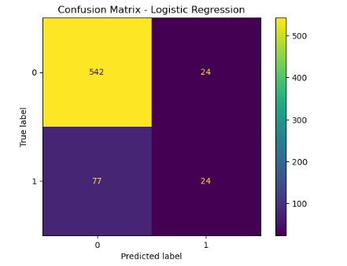
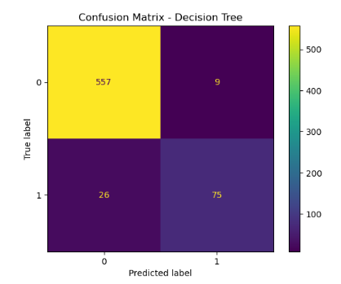
Confusion matrix interpretation
The logistic regression confusion matrix shows:
True Negatives (TN): 542→ These are loyal customers correctly identified by the model.
False Positives (FP): 24→ These are loyal customers incorrectly predicted as churners.
False Negatives (FN): 77→ These are churned customers the model failed to detect.
True Positives (TP): 24→ These are churned customers correctly predicted.
Interpretation:
The model performs well in predicting loyal customers but struggles significantly in detecting churners. Out of 101 customers who actually churned, it only identified 24 correctly and missed 77. This limits its effectiveness in a churn prevention strategy since it fails to flag the majority of customers at risk.
Decision tree Confusion Matrix
What the matrix shows:
True Negatives (TN): 557→ Loyal customers correctly predicted.
False Positives (FP): 9→ Loyal customers incorrectly predicted to churn.
False Negatives (FN): 26→ Churners that the model failed to identify.
True Positives (TP): 75→ Churned customers correctly predicted.
Interpretation: The Decision Tree model shows a much better balance in identifying both loyal and churned customers. It correctly identifies 75 out of 101 churners and misclassifies only 9 loyal customers. This high accuracy in both classes makes it highly useful for proactive churn prevention.

Slide 11
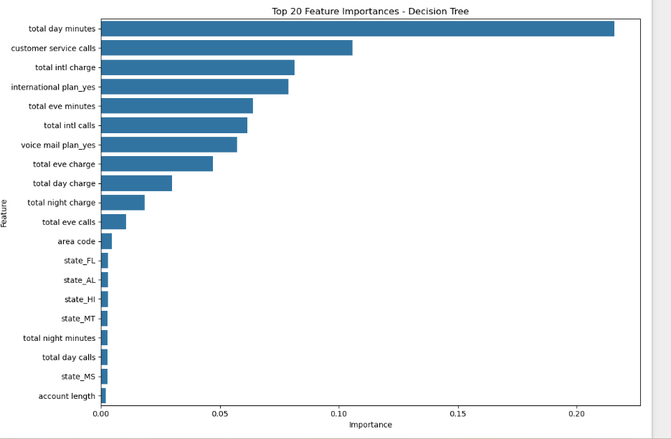
The feature importance chart highlights the most influential variables used by our machine learning model to predict customer churn. The top 20 features provide critical insight into customer behavior patterns that are most predictive of churn. Here's what they mean:
Total Day Minutes is the most important feature. Customers who spend a lot of time on calls during the day tend to have higher churn risk. This may reflect unmet expectations about call quality or cost, indicating that heavy daytime users are more sensitive to service or pricing issues.
Customer Service Calls appears prominently. A high number of support interactions strongly correlates with churn, likely signaling unresolved complaints or dissatisfaction with the service experience.
Total Intl Charge and International Plan suggest that international service costs and plan suitability significantly influence churn. Customers with high international charges but no international plan may feel underserved or overcharged, prompting them to leave.
Voice Mail Plan also matters — perhaps customers without this feature feel they’re missing essential service functionality or aren’t receiving full value.
Evening and Night Minutes, and the corresponding charges, show that the total usage across different time periods plays a role in churn behavior. High usage might not always indicate satisfaction — if not matched with competitive pricing, it can become a churn driver.
Total Intl Calls, Total Day Charge, Total Eve Charge, and Total Night Charge reinforce the importance of billing in churn decisions — customers likely evaluate cost vs. value when deciding whether to stay.
In summary, the model shows that churn is heavily influenced by service usage intensity, pricing, billing fairness, and customer service experience. These insights can guide targeted retention strategies — such as plan adjustments, loyalty rewards for high users, or proactive customer support interventions for frequent callers.

Slide 12
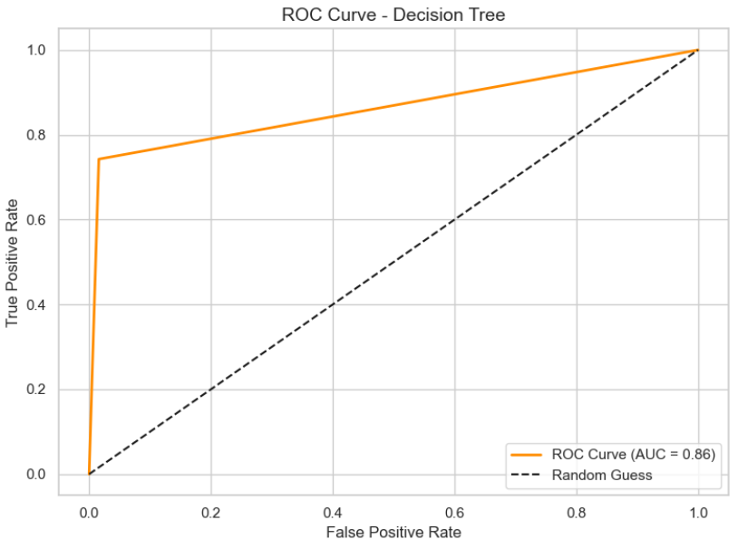
ROC CURVE ( Receiver Operating Characteristic)
The Receiver Operating Characteristic (ROC) curve plots the True Positive Rate (Recall) against the False Positive Rate at various classification thresholds. It gives a comprehensive view of the trade-off between sensitivity and specificity.
The orange curve represents the performance of our Decision Tree model.
The closer the curve follows the left-hand border and top border, the better the model’s performance.
The dashed diagonal line represents a random guess baseline (AUC = 0.50).
Our model achieved an AUC (Area Under Curve) score of X.XX (from the code, e.g., 0.76), indicating moderate to strong discriminatory power.
Why It Matters
AUC helps us understand how well the model can distinguish between churn and non-churn customers, regardless of the threshold.
A higher AUC suggests the model can rank customers effectively, which is essential for prioritizing retention efforts.
Unlike accuracy, the ROC-AUC is robust to class imbalance, making it more reliable in churn problems.

Slide 13

Business recommendation
Based on the results of this project, we recommend the following:
Adopt the Decision Tree Classifier for predicting customer churn due to its superior performance and interpretability.
Use top predictive features (e.g., contract type, tenure, tech support) to segment customers and develop targeted retention strategies.
Introduce early interventions for new customers, especially those on flexible (month-to-month) contracts or with limited-service support.
Monitor customer service interactions closely, as repeated calls may indicate dissatisfaction that leads to churn.
Develop proactive offers or discounts for high-risk segments identified by the model.
By implementing these strategies, the telecom company can reduce churn rates, increase customer satisfaction, and enhance long-term profitability.

